Slide 1

Survival Prediction On the Titanic
LIN Huangjing
WANG Xi
Dec. 8th 2016

Slide 2
01
Background and problem
02
Data preprocessing
Outline
03
Classification strategies
04
Results and analysis
05
Conclusion

Slide 3
01
Research Background & Problem Introduction
PART ONE

Slide 4
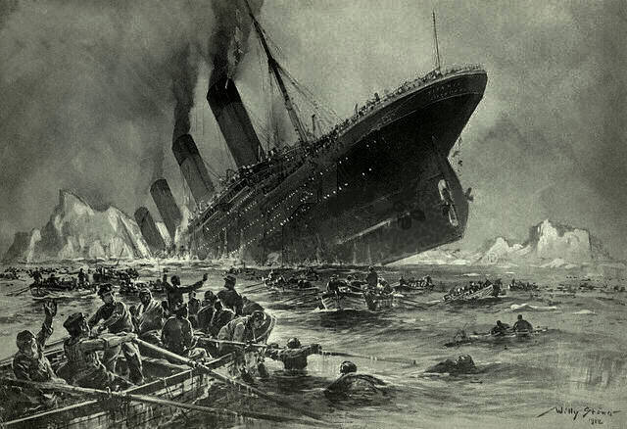
1.1 Background
This is one of the challenge from Kaggle website, with the title “Titanic: Machine Learning from Disaster”
The sinking of the RMS Titanic is one of the most infamous shipwrecks in history. It happened on the night of 14th April through to the early morning of 15th April 1912, during her maiden voyage, the Titanic sank after colliding with an iceberg, killing 1502 out of 2224 passengers and crew.
Reasons:
Misjudgment and wrong operation;
Warning delay;
Improper material used to build hull;
Deficient lifeboats.
Notes:
The tremendous disaster might ascribe to various factors, such as Misjudgment and misoperation; Warning delay; Improper material used to build hull; However, deficient lifeboats prepared on the Titanic for the passengers and crew is the direct reason which results such loss of life. In reality, over 1000 thousand of people were still on the boat when the Titanic sank.
During the process of rescue, women, children and the upper-class were given the priority to board the lifeboat.

Slide 5
1.2 Problem
Sex
Find effect algorithm
Passenger Class
Age
Given the train data regarding passenger’s information with survival labels, predict test data without labels.
Passenger Information
Name
Fare
To make better safety regulations and rescue strategy.
······
Notes:
The target of this challenge is to analyze and predict that what sort of people tended to survive the tragedy. The information about passengers is given including their name, age, sex, class and fare. Training data with survival label is provided for us to train classifier model which is used later to predict the test data.
The meaning of this project is to make better safety regulations and rescue strategy afterwards.

Slide 6
02
PART TWO
Data Preprocessing

Slide 7
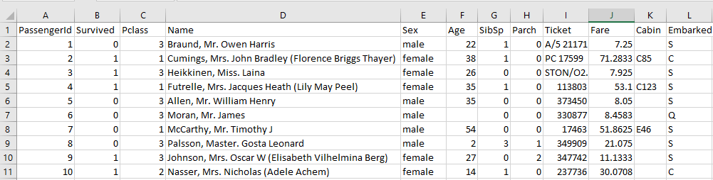
2 Data Preprocessing
Table1. Training data
11 attributes
Table2. Description about data set
Survived | Suvival (0 = No; 1 = Yes)
Pclass | Passerger Class (1 = 1st; 2 = 2nd; 3 = 3rd)
Name | Name
Sex | Sex
Age | Age
SibSp | Number of Siblings/Spouses Aboard
Parch | Number of Parents/Children Aboard
Ticket | Ticket Number
Fare | Passenger Fare
Cabin | Cabin
Embarked | Port of Embarkation (C = Cherbourg; Q = Queenstown; S = Southampton)

Slide 8
2 Data Preprocessing
Problems in raw data:
Missing values: Age, Ticket, Cabin and Embarked
Redundant fields: The title in Name and Sex (Mr. -> male and Mrs ->female)
Irrelevant attributes: PassengerId
Solutions:
Fill in missing values
Combine or remove redundant fields
Remove Irrelevant attributes

Slide 9

2.1 Data cleaning——Fill in missing values
Embarked:
Fill the two missing values with the mode value “S” which occurs most frequently in the training data.
Fare:
Fill the one missing value with the mode value “8.05”.
Age:
1) Parch=0, fill the missing values with the average age which is based on the feature ‘Parch=0’;
2) Parch>0, fill the missing values with the average age which is based on the feature ‘Parch>0’.
Notes:
Parch=0 indicates that the person is an adult. Parch>0 denotes that there is kid or one of parent. For Parch>0, you can try to analysis the Fare to identify which kid or adult is. Here just simple illustrate in the table.
表格是举的个简单例子，标红部分是缺失数据44.5=（35+54）/2;14.5=（2+27）/2.

Slide 10
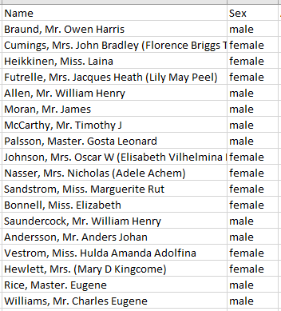
2.1 Data cleaning——Reduce redundant features
Name:
‘Name’ consists of the full name of passenger as well as different titles.
Notes:
‘Name’ consists of the full name of passenger as well as different titles, such as ‘Mr.’, ‘Mrs.’, ‘Miss’, ‘Master.’ and so forth which can be simply replaced by ‘Sex’ attribute to identify gender.

Slide 11
2.1 Data cleaning——Remove irrelevant features
PassengerId:
It is just about the sequence number for records.
Ticket:
‘Ticket’ stands for the ticket number which is trivial for our project.
Cabin:
Missing most of information.

Slide 12
2.2 Coding——Feature selection & Data transformation
Feature selection:
Delete PassengerId, Name, Ticket and Cabin columns.
Keep 7 features: Pclass, Sex, Age, SibSp, Parch, Fare and Embarked.
Data Transformation:
Covert ‘Sex’ male-female to 1-2
Covert ‘Embarked’ C-Q-S to 1-2-3

Slide 13
03
PART THREE
Classification Strategies

Slide 14
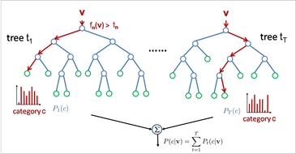
3.1 Classification Strategies-Random Forest
Random Forest
Based on the theory of decision tree
Based on swarm intelligence
Select features randomly to generate many decision trees
Parameter
Number of tree = 500

Slide 15
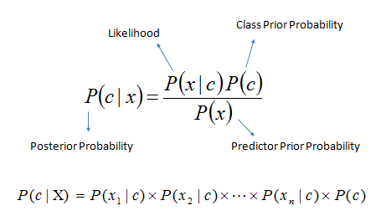
3.2 Classification Strategies-Naive Bayes Algorithm
Naive Bayes Algorithm
Based on the theory of prior probability
Based on the statistic information of training samples
Predict the results with probability
Parameter
Data distribution
‘kernel’: Kernel smoothing density
‘normal’: Normal (Gaussian) distribution

Slide 16
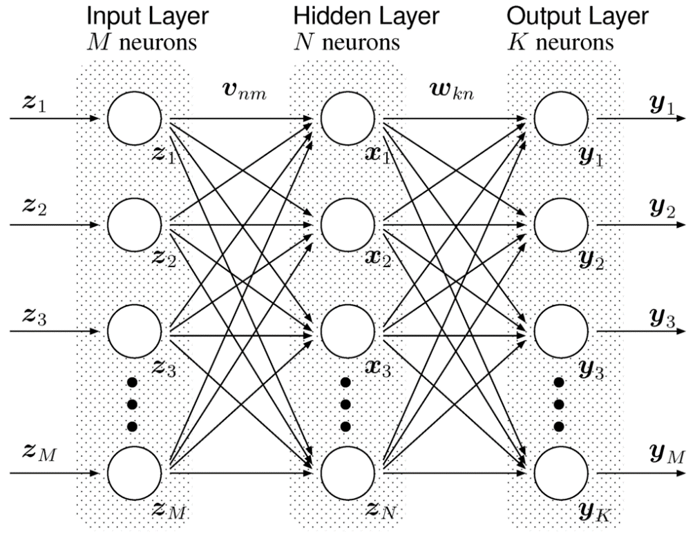
3.3 Classification Strategies-Multi-Layer Perceptron
Multi-Layer Perceptron
Based on the theory of neural network
Deep network with strong capability in classification
The deeper, the more data are needed for training
Parameter
Deep Brief Network (DBN)
Layer = 100

Slide 17
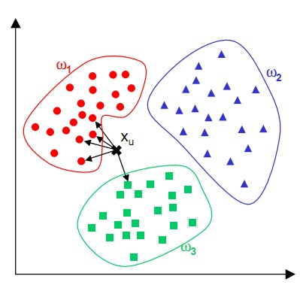
3.4 Classification Strategies-Multi-Layer Perceptron
K-Nearest Neighbors
Based on the theory of clustering
The classification depends on the voting results of the K nearest neighbors
Parameters
K = 5
Similarity measurement:
Cityblock
Euclidean

Slide 18
04
Results
PART FOUR

Slide 19
4.1 Results
Training Data
2/3
1/3
Training
Validation
Method | Accuracy (Training Data) | Accuracy (Testing Data)
Random Forest | 0.8152 | 0.76555
Naïve Bayes Algorithm (Normal) | 0.7849 | 0.73206
Naïve Bayes Algorithm (Kernel) | 0.7524 | 0.71292
Multi-Layer Perceptron | 0.7785 | 0.77512
K-NN (Cityblock) | 0.8066 | 0.76077
K-NN (Euclidean) | 0.8045 | 0.78469
Notes:
Due to lack of the groudtruth of testing data, we firstly train our models on training data by splitting it into two parts, 2/3 for training and 1/3 for validation.

Slide 20
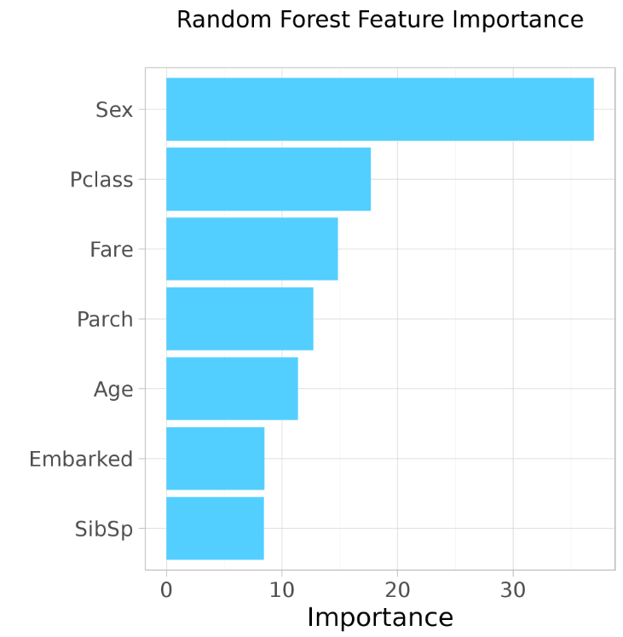
4.2 Analysis-Feature Importance
Notes:
Feature importance is obtained by using random forest method. Obviously, ‘Sex’ occupies the lion’s share, followed by Passengers class. Because, women are given precedent to use lifeboats.
On the contrast, embarked and sibsp are less important features among these 7 attributes.

Slide 21
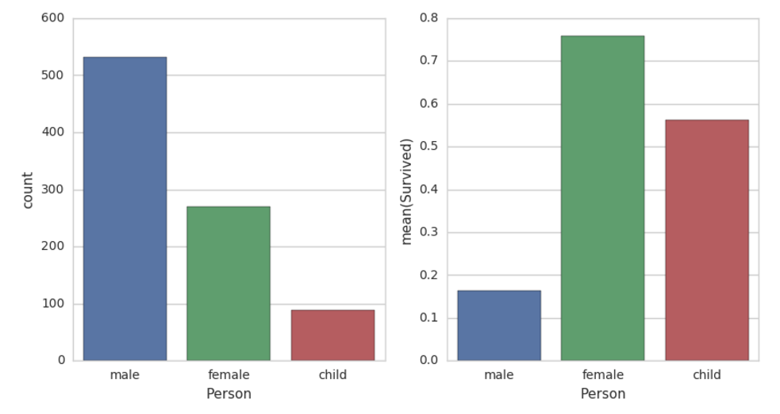
4.2 Analysis-Sex
Notes:
As the figure shows, the number of male is much larger than female. However, the percentage of survival among female considerably overwhelms that of male.

Slide 22
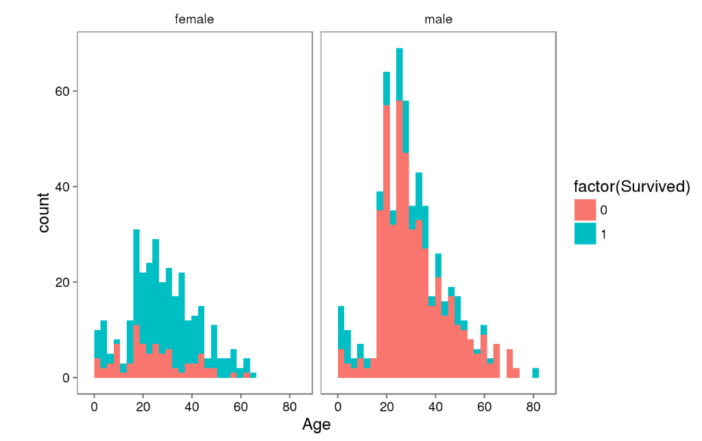
4.2 Analysis-Age and Sex
Notes:
As the figure shows, the number of male is much larger than female. However, the percentage of survival among female considerably overwhelms that of male. Children and young people are more likely to survive.

Slide 23
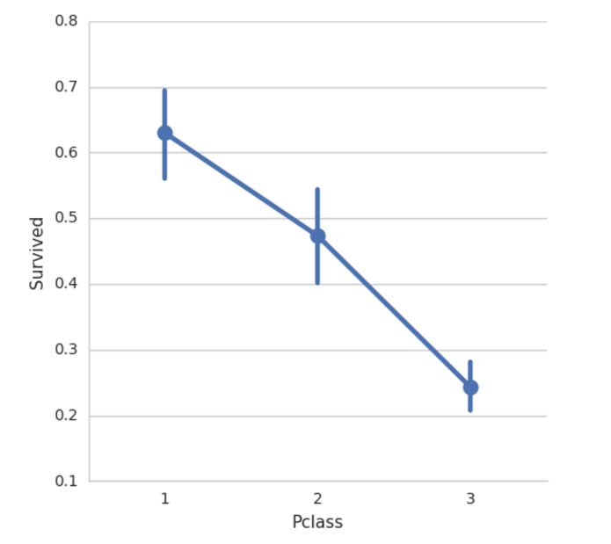
4.2 Analysis-Pclass
Notes:
The upper-class have highest probability to survive.

Slide 24
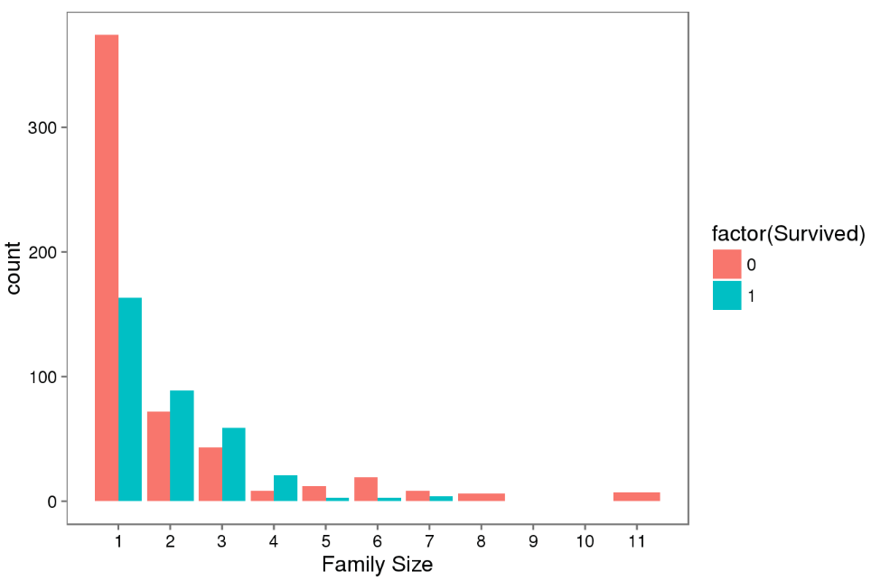
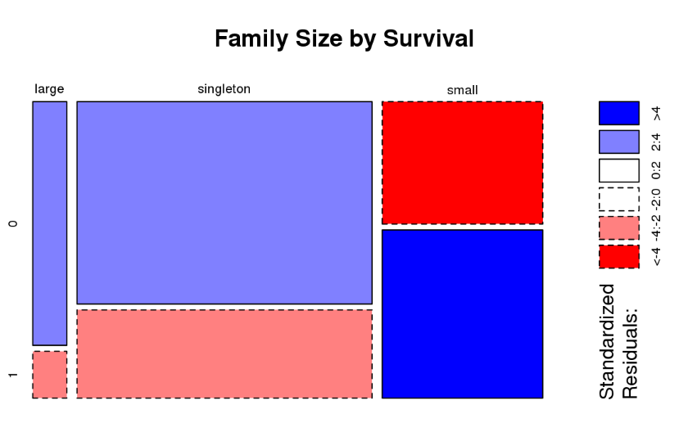
4.2 Analysis-Family size
Here, “Family” results from the result of combining “SibSp” with “Parch” features.
Notes:
Then, we turn to analyze the relationship between family size and survival.
We can see that there’s a survival penalty to singletons and those with family sizes above 4.

Slide 25
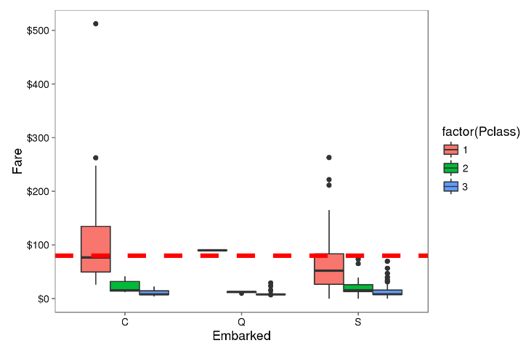
4.2 Analysis-Relationship between Fare and Embarked
Notes:
The median fare for a first class passenger departing from Charbourg (‘C’) coincides nicely with the $80 paid by our embarkment-deficient passengers.
I think we can safely replace the NA values with ‘C’.

Slide 26
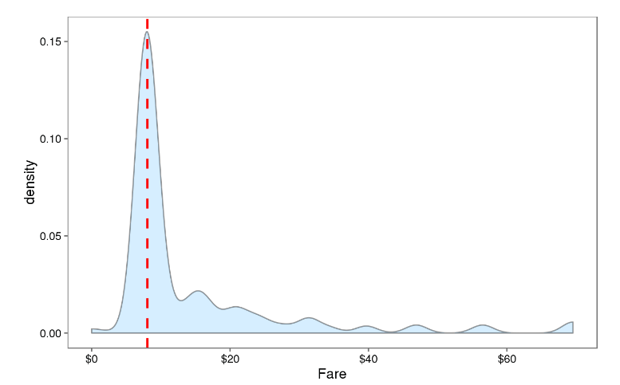
4.2 Analysis-Fare
$8.05
Notes:
From this visualization, it seems quite reasonable to replace the NA Fare value with median for their class and embarkment which is $8.05.

Slide 27
05
Conclusion
PART FIVE

Slide 28
Conclusion
1
1
Compared different classification methods.
Preprocess is not enough.
Gain
Cons
2
2
Robustness is not strong.
Find the important attributes.
3
3
Analyzed relationship among various features.
Accuracy needs to be improved.

Slide 29
Reference
[1]https://www.kaggle.com/c/titanic
[2]https://en.wikipedia.org/wiki/Sinking_of_the_RMS_Titanic
[3]https://www.kaggle.com/c/titanic/data
[4]https://www.python.org/
[5]Breiman L. Random forests[J]. Machine learning, 2001, 45(1): 5-32.
[6]Hornik K, Stinchcombe M, White H. Multilayer feedforward networks are universal approximators[J]. Neural networks, 1989, 2(5): 359-366.
[7]Russell S J, Norvig P, Canny J F, et al. Artificial intelligence: a modern approach[M]. Upper Saddle River: Prentice hall, 2003.
[8]Altman N S. An introduction to kernel and nearest-neighbor nonparametric regression[J]. The American Statistician, 1992, 46(3): 175-185.

Slide 30
Q&A
THANKS！
Notes:
我的研究工作汇报到此结束，还请各位评委老师多批评指正，让我在今后的学习中学到更多，谢谢！

